Slide 1

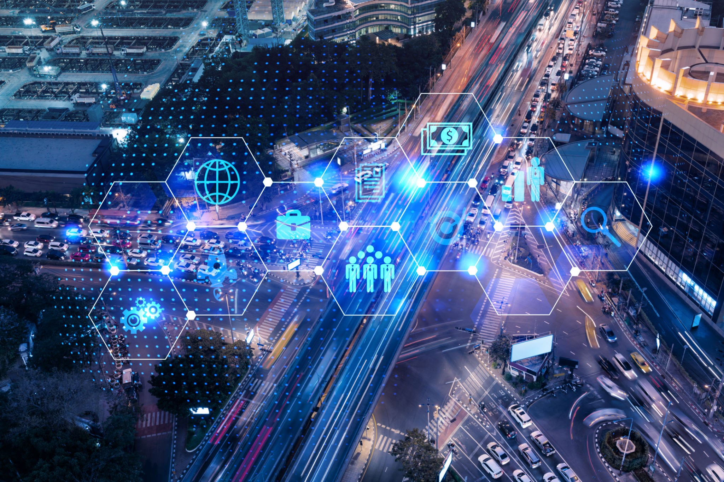



ANPR and ATCC – Smart Traffic Management System
Infosys Springboard Virtual Internship

Slide 2
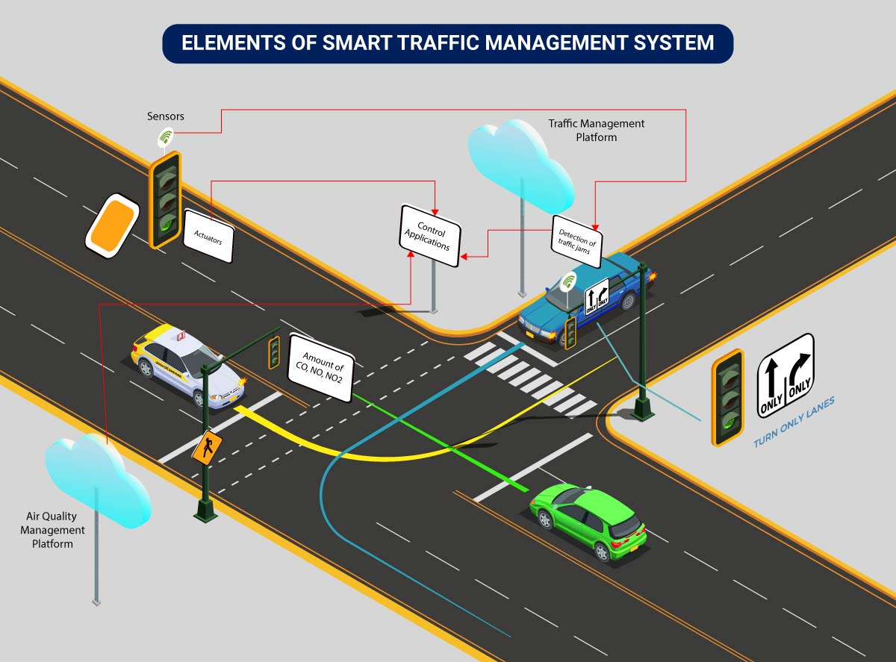

Introduction: Smart Traffic Management
Smart Traffic Management: Using technology like AI to automate and optimize urban traffic flow.
Why ANPR + ATCC: ANPR identifies vehicles, while ATCC monitors compliance, creating a full enforcement loop.
Automation Benefits: Drastically improves safety, reduces congestion, and ensures efficient monitoring.
Project Objective: To build an intelligent, automated system for real-time traffic monitoring and violation detection.

Slide 3
Problem Statement
The project addresses critical challenges in modern traffic management using automated, real-time systems:
Improving Traffic Flow: Existing infrastructure often fails to dynamically adjust to traffic volume, leading to persistent **congestion** and delays.
Inefficient Monitoring: Reliance on manual monitoring for compliance is **prone to errors** and lacks the scalability for continuous 24/7 surveillance.
Delayed Enforcement: The slow process of identifying vehicle license plates and tracking movements manually hinders **timely enforcement** and incident response.
Enhancing Road Safety: There is a critical need for an automated system to improve road safety by proactively **detecting and recording violations** (e.g., red light, helmet, triple riding) in real-time.

Slide 4
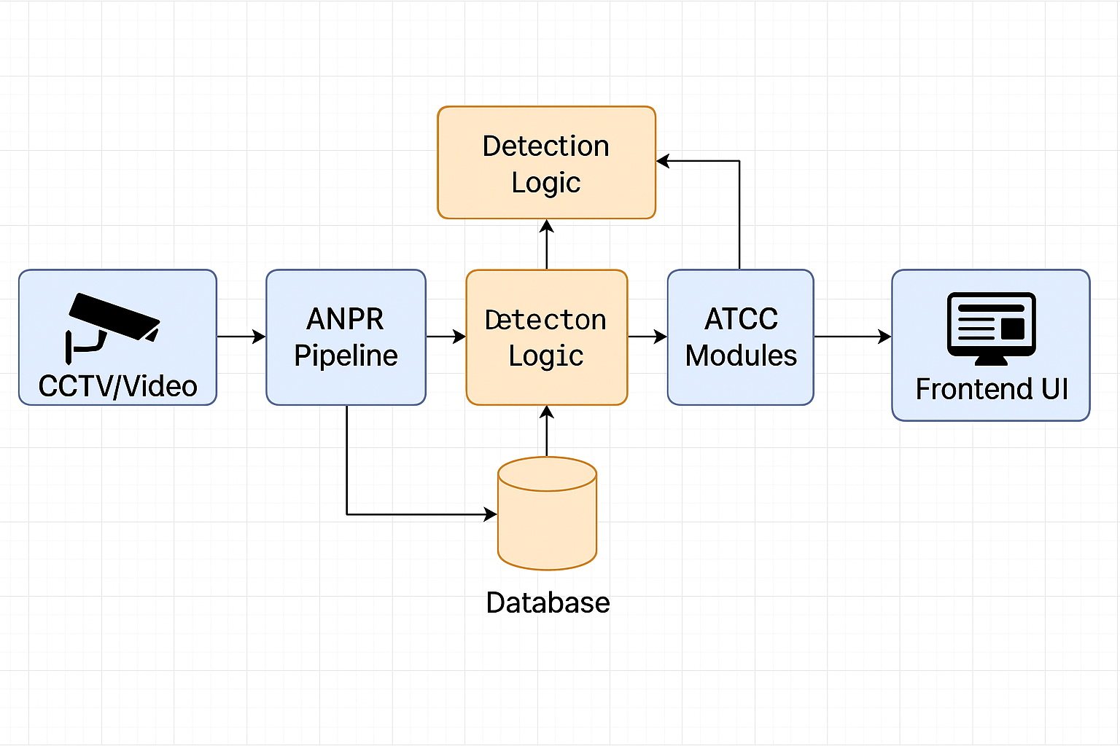

System Architecture
Input Layer: Live video feeds from CCTV cameras are the primary data source.
Processing Pipeline:
ANPR: Detects and recognizes license plates.
ATCC: Runs violation detection modules (red light, helmet, etc.).
Data Layer: A MySQL database stores all vehicle data and violation records.
Presentation Layer: A Flask-based web UI provides a dashboard for live monitoring, search, and reports.

Slide 5
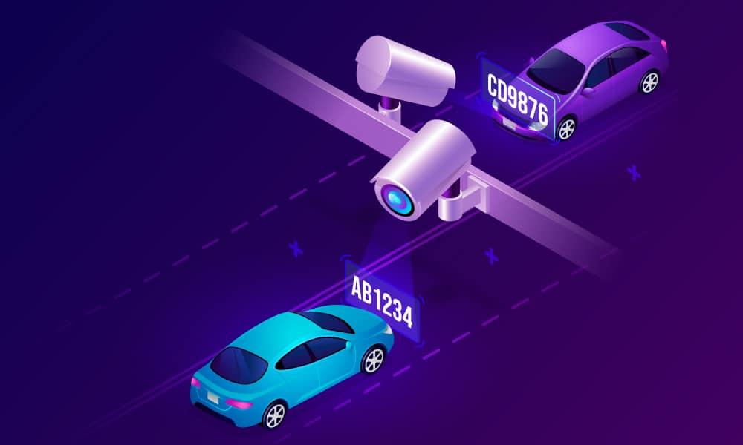
ANPR (Automatic Number Plate Recognition)
Plate Detection: A deep learning model first identifies the bounding box of the license plate in the frame.
Character Segmentation: The plate region is processed to isolate each individual character.
OCR Recognition: Optical Character Recognition (OCR) is applied to convert the character images into text.
Database Storage: The recognized plate number, timestamp, and location are saved to the database.

Slide 6
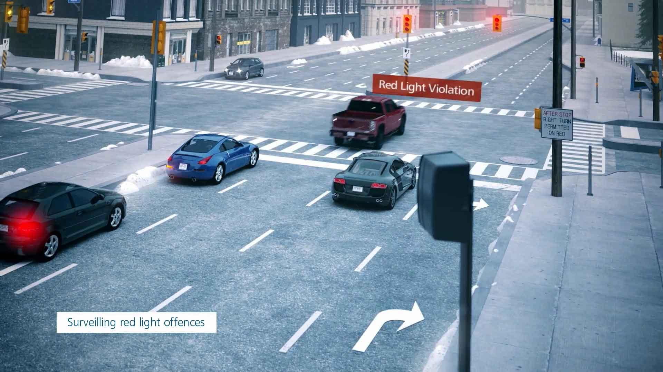
ATCC (Automatic Traffic Compliance & Control)
What is ATCC? A system that automatically monitors video feeds to detect traffic rule violations.
Role in Enforcement: Provides the "compliance" part of the system, flagging violations as they happen.
How AI Helps: Uses object detection (YOLO) and custom logic to identify complex scenarios like helmet-less riding or red-light violations.

Slide 7
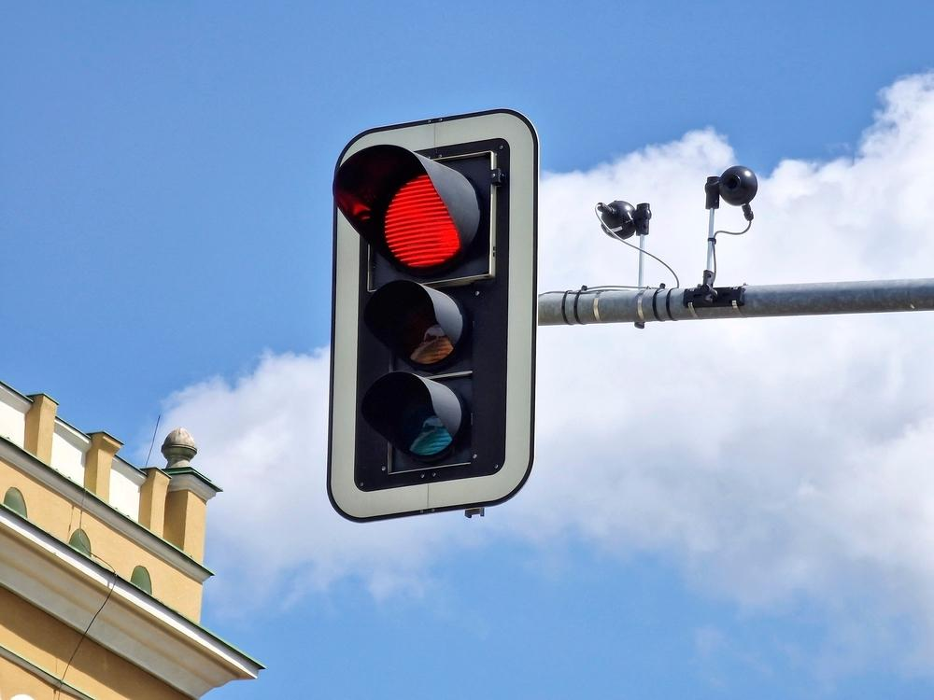
ATCC Module: Red Light Violation
Signal Detection: The system identifies the state of the traffic light (Red, Green, Yellow).
Violation Zone: A "stop-line" or virtual zone is defined in the camera's view.
Violation Logic: If a vehicle's bounding box crosses the zone while the light is RED, a violation is triggered.
Data Capture: The system captures the frame and sends the license plate (from ANPR) to the violation database.

Slide 8
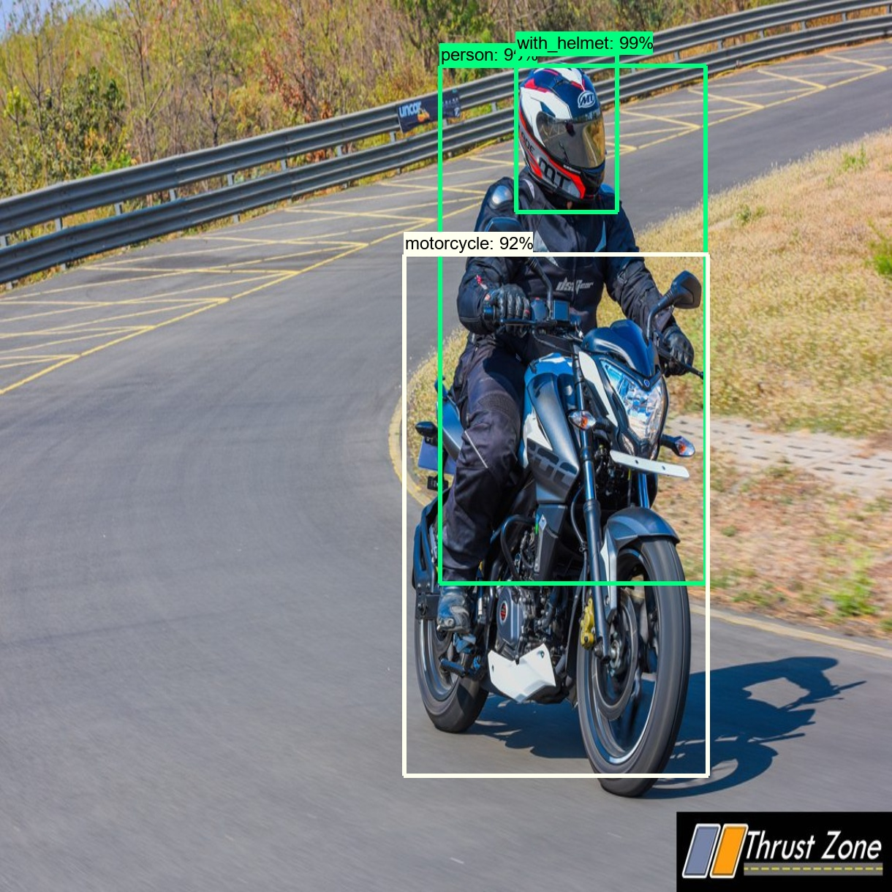
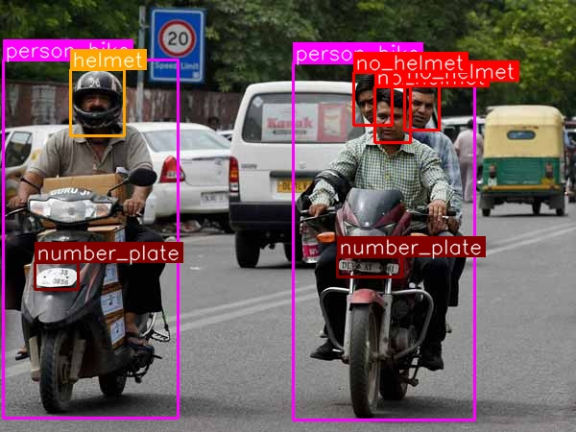

ATCC Module: Helmet Detection
Uses YOLO (You Only Look Once) to perform real-time object detection. The model is trained to identify two classes: 'rider' and 'helmet'. If a 'rider' is detected without a corresponding 'helmet' bounding box, a violation is flagged.
Helmet Detected
No Helmet Violation

Slide 9
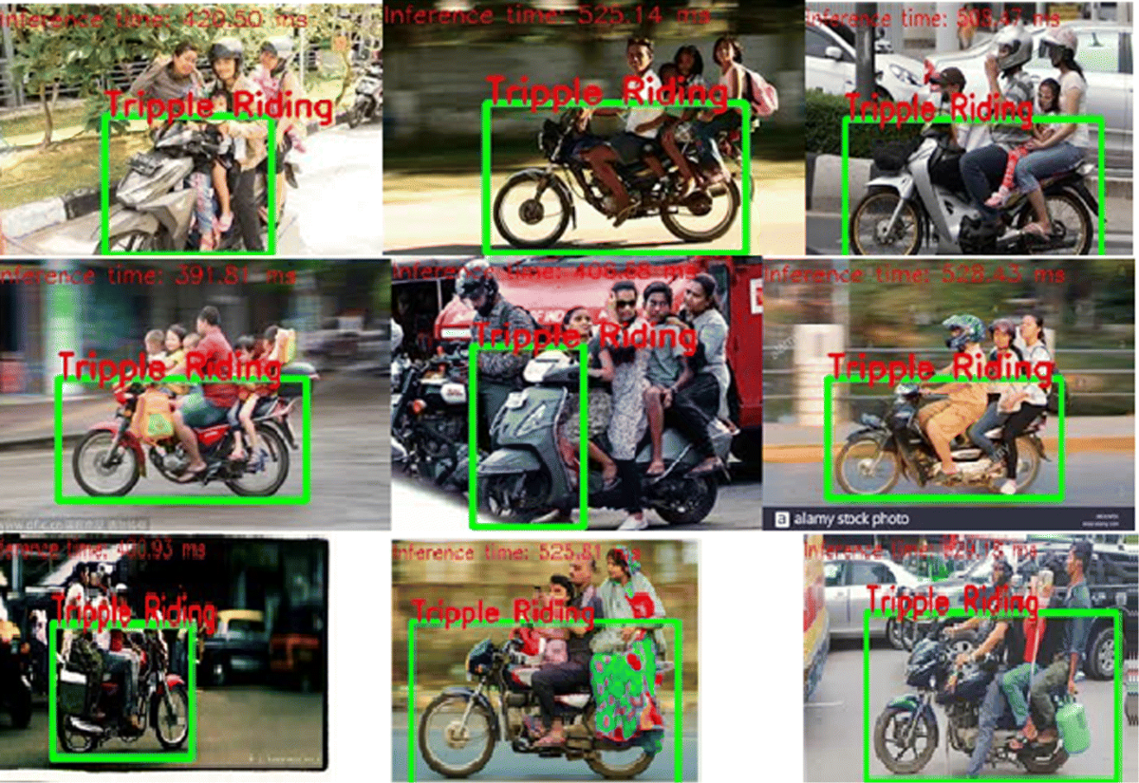
ATCC Module: Triple Riding Detection
Person Counting: The object detection model identifies all instances of 'person' on a 'motorcycle'.
Violation Logic: A custom script counts the number of 'person' bounding boxes associated with a single 'motorcycle' box.
Violation Trigger: If the count is greater than 2, a "Triple Riding" violation is recorded against the vehicle's ANPR.

Slide 10
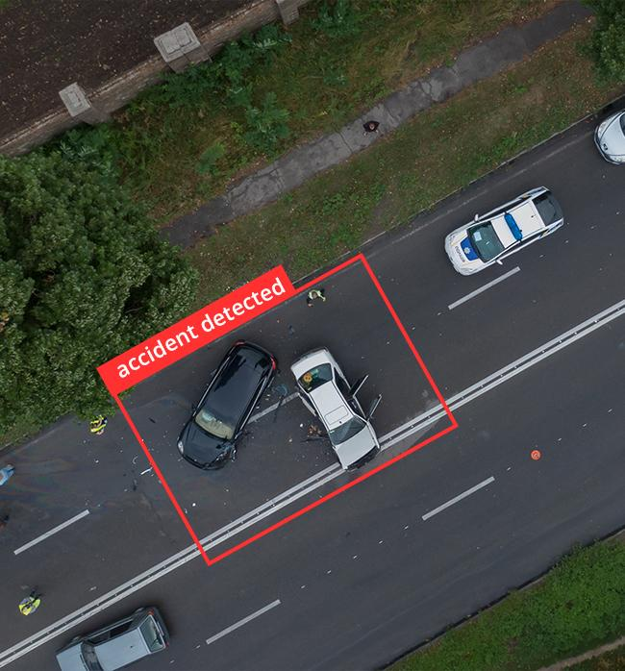
ATCC Module: Accident Detection
Identification Logic: This module analyzes vehicle behavior, tracking speed and direction.
Behavior Analysis: Detects sudden, erratic stops, changes in trajectory, or vehicles that remain stationary in active traffic lanes.
Alert Generation: When accident-like behavior is confirmed, the system automatically generates an alert for emergency services and traffic managers.

Slide 11
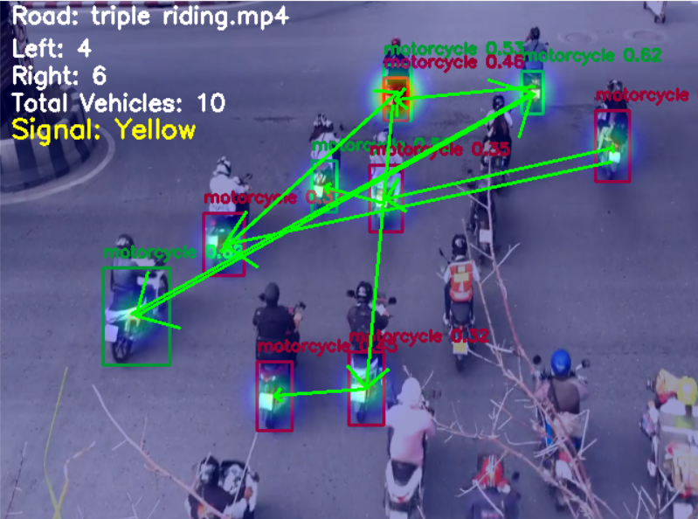
ATCC Module: Heatmap Visualization
Traffic Density: Heatmaps provide an intuitive visual representation of traffic density and congestion.
How it Works: The system aggregates vehicle counts (from ATCC) in specific zones over time.
Color-Coded Analysis:
■ Red: High congestion
■ Yellow: Moderate traffic
■ Green: Smooth flow
Importance: Helps traffic managers identify bottlenecks and optimize signal timing.

Slide 12
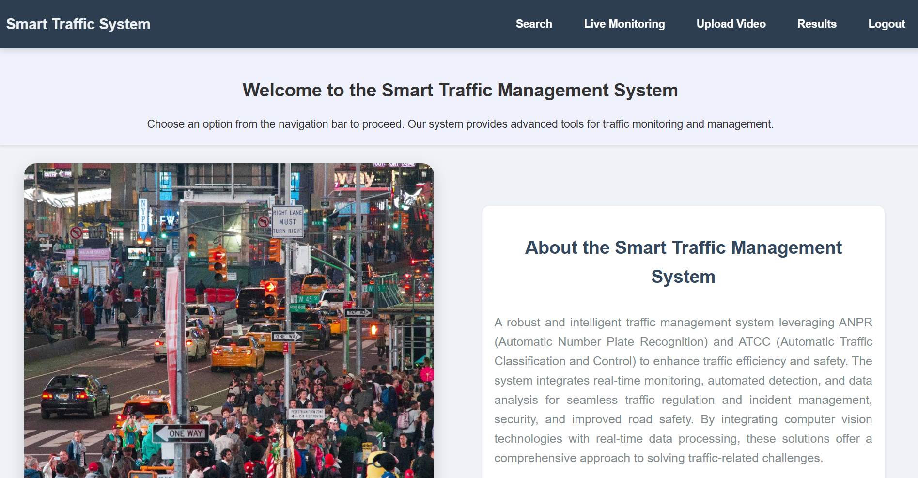


User Interface (UI) Mockup
The unified platform features live monitoring, search, upload video, and results pages for comprehensive traffic management.

Slide 13
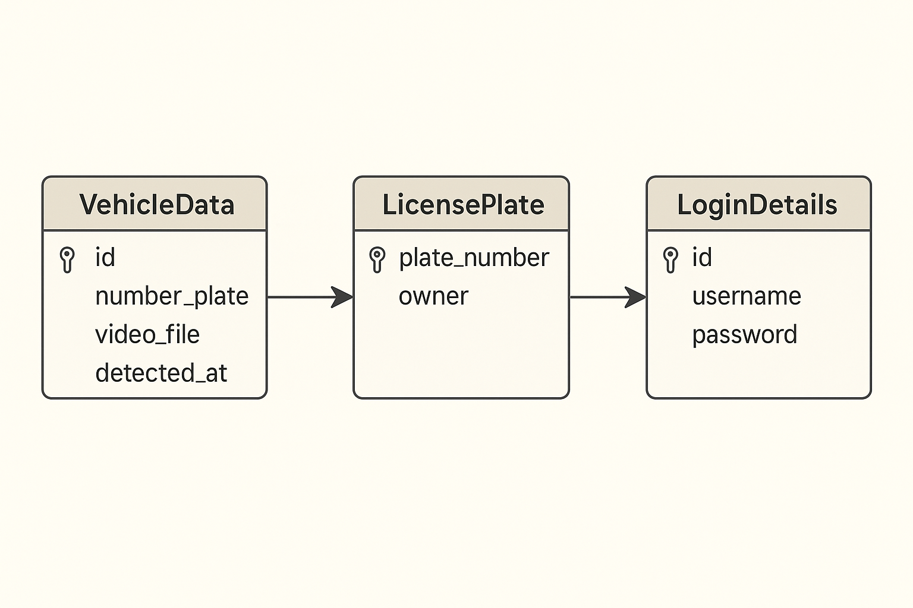
Database Design (MySQL)
A relational database is used to link all data points efficiently.
`vehicle_data` (ANPR): Stores every recognized license plate with a timestamp and camera ID.
`license_plates` (Violations): Stores confirmed violations, linked to `vehicle_data` via a foreign key. Includes violation type and evidence.
`login_details`: A simple table to manage user authentication for the dashboard.

Slide 14
Technology Stack
Python: Core language for all backend and ML tasks.
Flask: Lightweight web framework for the backend API and UI.
OpenCV: Used for real-time computer vision and image processing.
HTML/CSS/JS: Standard technologies for the frontend dashboard.
TensorFlow: Framework for building and training deep learning models.
MySQL: Relational database for storing all vehicle and violation data.
YOLO: State-of-the-art model for real-time object detection.
Git & GitHub: For version control and project collaboration.

Slide 15


Conclusion
Project Achievements
Benefits & Impact
Successfully designed and integrated a complete ANPR and ATCC system. Built multiple, parallel-processing modules for comprehensive violation detection (red light, helmet, triple riding).
The system provides a scalable, real-time, and automated solution to enhance traffic enforcement, improve road safety, and optimize traffic flow, forming a cornerstone for a smart city.

Slide 16
Thank You
Any Questions?

